Slide 1
Undirected ST-Connectivity in Log-Space
(Omer Reingold, 2005)
Speaker: Roii Werner
TexPoint fonts used in EMF.
Read the TexPoint manual before you delete this box.: AAAAAAAAAAAA

Slide 2
Introduction
The USTCON problem:
Input: , where is an undirected graph and
Output: YES if there is a path from to in ,
NO otherwise.
(The suggested algorithm also solves the corresponding search problem, i.e. finds the path if it exists)

Slide 3
Introduction
The Complexity class SL:
[LP82]:
Symmetric Turing Machine: a TM with limited nondeterministic power (in a symmetric TM the configuration graph is undirected).
SL is the class of problems solvable by a symmetric TM.
USTCON is complete for the class SL under Log-Space reductions.
[Rei05]:
A deterministic Log-Space algorithm for USTCON.
A direct corollary: L = SL.

Slide 4
Introduction
Previous results on USTCON:
Time complexity is linear (BFS, DFS). In fact, this applies for STCON. But these algorithms require linear space.
[Sav70] An algorithm for STCON in space (and super-polynomial time).
[AKL+79] A randomized Log-Space algorithm (in fact, any random walk will do). This showed that
[NSW89]
[SZ99]
[ATSWZ00]
[Tri05] space deterministic algorithm

Slide 5
The idea
To solve a connectivity problem on a graph, we could first improve its connectivity. More specifically, we will apply some transformation which turns each connected component of the original graph into an expander of constant degree.
Once the connected component of is a constant degree expander, the problem becomes easy:
Enumerate all logarithmically long paths starting with and check if any of them visits .
Since expander graphs have logarithmic diameter, the algorithm is correct.
Since the degree is constant, the number of logarithmically long paths is polynomial and hence they can be iterated in log space.
The main question – how to transform an arbitrary undirected graph into one with the desired properties (and perform this transformation in log space)?

Slide 6
Preliminaries
Graph representations:
Adjacency matrix: the entry is the number of edges going from to (self loops and parallel edges are allowed). We discuss undirected graphs, so this matrix is symmetric (in particular, all of its eigenvalues are real).
A graph is D-regular if the sum of entries in each row (and column) is D.
Rotation map:
For a D-regular graph, we would like to assume some labeling of the edges (i.e. so that we can refer to the “i’th neighbor of v”).
Definition:

Slide 7
Preliminaries
Expanders:
An expander is a sparse graph which is nevertheless highly connected. There are several ways to measure the expansion of a graph. For our discussion, we’ll use the algebraic notion of expansion:
The normalized adjacency matrix M of a D-regular undirected graph G, is the adjacency matrix of G divided by D. In terms of the rotation map, we have:
M is the transition probability matrix of a random walk on G.
1 is an eigenvalue of M (for the eigenvector (1,1,…,1)), and all eigenvalues have absolute value .

Slide 8
Preliminaries
Expanders:
We denote by the second largest eigenvalue (in absolute value) of M.
Definition:
An is a D-regular graph on N vertices such that
measures the expansion properties of G. More specifically:
[AM85] For every there exists such that for every
G and for any set S of at most half the vertices of G,
at least vertices of G are connected by an edge to some vertex in S.
This implies that G has logarithmic diameter:

Slide 9
Preliminaries
Proposition 1:
Let be some constant. Then for any and any two vertices , there exists a path of length which connects s and t.
Proof:
By the vertex expansion of , for some both s and t have more than vertices at distance at most from them in . Therefore, there must exist a vertex that is of distance at most from both s and t.

Slide 10
Preliminaries
Proposition 2:
Let be some constant. Then there exists a space algorithm such that for a D-regular graph G on N vertices, the following hold:
1. If s and t are in the same connected component and this component is an -graph then outputs “connected”.
2. If outputs “connected” then s and t are in the same connected component.
Proof:
enumerates all paths of length from s (the constant hidden in the big O depends on as in proposition 1). It outputs “connected” if it encounters t.
2 is trivial, 1 follows from the previous proposition.

Slide 11
Preliminaries
Expanders of constant degree have been proven to exist and various explicit constructions have been given.
Proposition 3:
There exists some constant and a -graph.
Lemma 4:
For every D-regular, connected, non-bipartite graph G on , it holds that
In other words, for such a graph, the spectral gap is at least inverse polynomial in N.
A natural way to amplify the spectral gap of a graph is by powering:

Slide 12
Preliminaries
Powering:
Definition:
Let G be a D-regular multigraph on given by . The ‘th power of G is the -regular graph given by:
where
Proposition 5:
If G is an -graph, then is an -graph.
While powering amplifies the spectral gap, it also increases the degree. We are interesting in producing constant-degree graphs, so now we need an additional operation which maintains the expansion properties of the graph and reduces its degree.

Slide 13
Preliminaries
Graph products:
Replacement product:
Let G be a D-regular graph on N vertices, and H a d-regular graph on D vertices (d << D). The replacement product is defined as
follows:
  each vertex in G is replaced by a copy of H.
  For , denote the j’th vertex in the i’th copy by .
  If , then
  Additionally, if , then
  The replacement product graph is on ND vertices and is (d+1)-regular. While it may also be used for the algorithm, we’ll use another product which will ease the analysis.

Slide 14
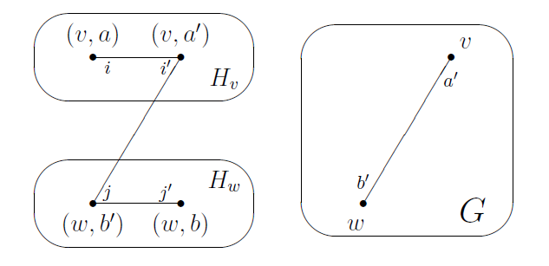
Preliminaries
The Zig-zag product:
Again, let G be a D-regular graph on N vertices, and H a d-regular graph on D vertices (d << D).
The set of vertices in the zig-zag product is the same as in the replacement product, but the edges correspond to “zig-zag” paths in , i.e. paths of length 3 which consist of a short edge, a long edge and another short edge.

Slide 15

Preliminaries
Definition ([RVW02]):
If G is a D-regular graph on , and H is a d-regular graph on , then the zig-zag product is a -regular graph on with the following rotation map:
1. Let
2. Let
3. Let
4. Output
A corollary from a theorem in [RVW02] gives a bound on the amount by which the spectral gap of might be smaller than that of G (recall that we wish to reduce the degree but without losing too much in expansion)

Slide 16


Preliminaries
Theorem 6 ([RVW02]):
If G is an -graph and H is a -graph, then is an -graph, where
Corollary 7:
If G is an -graph and H is a -graph, then
Proof:
Since , we have that
Therefore,

Slide 17

The main transformation
We may now describe the log space transformation which will transform each connected component of our input graph into an expander.
Definition (main transformation):
Given the rotation maps of G, a D -regular graph on [N], and H, a D-regular graph on [D ], the transformation outputs the rotation map of a graph defined as follows:
  Set l to be the smallest integer such that
  Set and for i > 0 define recursively by:
  Denote , and
It follows by induction that each is a D -regular graph over
In addition, if D is constant then and has vertices.
We want to show that when H is an expander, then is also an expander.

Slide 18
The main transformation
Lemma 8:
Let G and H be the inputs of . If and G is connected and non-bipartite then .
Proof:
By lemma 4, .
Therefore, by definition of l, it is enough to show that for all i > 0,
. Denote .
By corollary 7,
Therefore, by proposition 5,
Now, if then .
Otherwise, and therefore

Slide 19

The main transformation
So far, we’ve only considered how operates on connected graphs. In USTCON, our input graph need not be connected, but we’re only really interested in the connected component which contains s. We’d like to argue that operates separately on each connected component.
Lemma 9:
Let G and H be the inputs of . If is a connected component of G then
Proof:
consists of taking powers and zig-zag products, both operations which operate separately on connected components (proof by induction).
Before we proceed to put everything together, we still need to show that the transformation is log space (when D is constant).

Slide 20
The main transformation
Lemma 10:
For every constant D the transformation can be computed in space
on inputs G and H, where G is a D -regular graph on [N] and H is a D-regular graph on [D ].
Proof:
  : Input - G,H. Output - .
  A value in the domain of consists of
  and . The length of each is , so enumerating all these values can be done in log space.
  Remains to show that a single evaluation of can be done in log space.
  allocates variables v ~ [N], ~ [D ].
  specify a vertex name in H ( might also specify an edge label of G, and the rest might specify a sequence of 16 edges in H, in which case we denote

Slide 21
The main transformation
Evaluating :
  copies into and into . These variables will evolve until they eventually contain .
  operates recursively, analogous to the definition of . At each level of the recursion we evaluate on the appropriate prefix
  of the variables.
  For the base case , is written on the input tape and evaluation is performed by searching the tape for the desired entry.
  For larger i, evaluating is done as follows:
    For j = 1 to 16
      Set
      If j is odd,
      If j = 16, reverse the order of labels in :
      set

Slide 22
The main transformation
Analyzing :
Correctness – follows from the definition of .
Space complexity:
  each node of the recursion tree performs a constant number of operations and makes a constant number of recursive calls.
  The depth of the recursion is
  Therefore, maintaining the recursion can be done in space
  Basic operations (evaluating , reversing the labels) can all be done in space .
  only memory that needs to be kept after a basic operation is performed, is the memory holding the variables (that are shared by all of these operations), and the memory for maintaining the recursion.
  Conclusion: overall space complexity is .

Slide 23
The algorithm
Armed with our new set of tools, we may proceed to the algorithm.
Theorem 11:
USTCON L
Note: Since USTCON is SL-complete ([LP82]), this implies L = SL.
We will need to describe an algorithm:
: Input: (given in adjacency matrix representation).
  Output: “connected” iff s and t in the same connected component.
  Our algorithm will require a -graph H (which exists by proposition 3 and can be constructed explicitly or found by exhaustive search).
  But to apply the transformation we must first transform the input graph G into a graph which is a legal input for along with H. We’ll denote this transformed graph by .

Slide 24
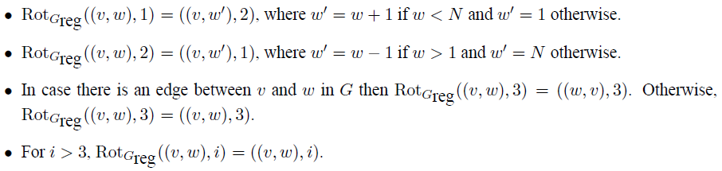
The algorithm
Computing :
  needs to be a -regular graph given by its rotation map.
  Informally, each vertex of G is replaced with a cycle of length N, and each vertex such that v and w are connected by an edge in G is also connected to (the rest of the edges are self loops).
  Formally, we define :

Slide 25
The algorithm
Analyzing :
Clearly computable in log space.
-regular by its definition, and every connected component is non-bipartite (because of the self-loops).
For every connected component of G, is a connected component in :
  For every , we have that is in the same connected component (connected by a cycle).
  There is an edge in between some vertex in and some vertex in iff v,w are connected by an edge in G.

Slide 26
The algorithm
Proof of theorem 11:
The algorithm will work as follows:
  Compute the graphs and H as described above.
  Define , and as in the definition of
  Run the algorithm (from proposition 2) on the graph with the vertices and and output its answer.
Correctness:
  Let S be the connected component of G such that .
  By the analysis of , is a connected component in it, and
  is non-bipartite.
  By lemma 9, is a connected component of (because and are both -regular).
  By lemmas 8 & 9,
  The correctness of follows from proposition 2.

Slide 27
The algorithm
Proof of theorem 11:
Space complexity:
is log space because it consists of a constant number of procedures we’ve already shown to be in log space:
  The transformation from G to .
  The transformation , computable in log space by lemma 10.
  The algorithm which is log space by proposition 2.
This completes the proof of theorem 11.

Slide 28
Universal traversal sequences
Definition:
A universal traversal sequence for D-regular graphs on N vertices is a sequence of edge labels in such that for any such graph, any labeling of its edges and any start vertex, the deterministic walk defined by these labels visits all the vertices in the graph.
  Explicit constructions of polynomially-long UTS are known for very limited classes of graphs (randomized construction given in [AKL+79]).
  We will show that the described algorithm implies construction of UTS in log space under some restrictions on the labeling of the edges.
  In addition, the algorithm for USTCON solves the corresponding search problem.

Slide 29
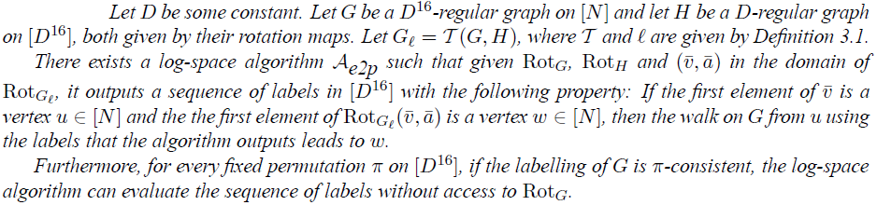
Universal traversal sequences
Definition:
Let be a permutation over [D] and the rotation map of a D-regular graph G. is if for every v,i,w,j such that
, it holds that . We may also refer to the labeling of G as .
Examples:
Symmetric labeling with being the identity.
The labeling of .
Lemma 12:

Slide 30
Universal traversal sequences
Proof:
Recall the evaluation performed by the algorithm (lemma 10). In particular, the variables .
At first v is initialized to the value u (the first element of ). At the end, it is guaranteed to contain w.
v is only updated by the rule at the base of the recursion.
Therefore, to obtain we may modify to output the value of each time before it updates v.
For the second part of the lemma: the evaluations
are all the influence has on the value of .
Therefore, if G is , we may ignore and v, and whenever we were going to update we may instead evaluate .

Slide 31
Universal traversal sequences
Given lemma 12, we can now solve the search problem corresponding to USTCON.
Theorem 13:
There exists a log space algorithm that gets as input (G,s,t) and outputs a path from s to t, if such a path exists (otherwise outputs “not connected”).
Proof:
  is just slightly modified.
  It is enough to output a path from (s,1) to (t,1) in (transforming it to the desired path in G is easily done in log space).
  enumerates all logarithmically long paths from .
  If none of them visits , can output “not connected”
  Otherwise, a path was found. We may apply on each edge in the path. Each time a sequence of edge labels in is outputted.
  By lemma 12, the concatenation of these sequences is the desired path.

Slide 32
Universal traversal sequences
Definition:
Let be a sequence of values in [D], and a permutation over [D]. is an (N,D) -universal traversal sequence, if for every connected, D-regular, labeled, -consistent graph G on N vertices, and any start vertex s, the walk starting from s and following the edges
visits every vertex in the graph.
Theorem 14:
There exists a log space algorithm which takes as input and a permutation over [D] and outputs an (N,D) -universal traversal sequence.

Slide 33
Universal traversal sequences
Proof of theorem 14:
  Define the permutation as follows: and for every .
  Given a connected, D-regular graph G on N vertices that has a -consistent labeling, we can transform it into a -regular (connected and non-bipartite) graph G’ on ND vertices that has -consistent labeling (this is done in a similar fashion to the definition of ,
  but now the edge labeled 3 going out of (v,i) will lead to ).
  We’d like to find (roughly) a UTS on G’ and translate it into on G.
  Assume a sequence of labels visits every vertex of G’ starting from any vertex (v,1). We translate this (in log space) into a sequence of labels that traverses G from any vertex v.
  We simulate a walk on G’, beginning at an arbitrary vertex (v,1). We’d like to track the value b at each point in the walk such that at that point we are at vertex (w,b) for some w.

Slide 34
Universal traversal sequences
Proof of theorem 14:
  First b is set to 1. During the simulation, labels can be ignored (they are self loops). If the label is 1 or 2, updating b is easy (these are edges on the cycle). If the label is 3, then the walk moves from (w,b) to (because G is -consistent).
  Therefore, to transform the sequence of ‘s to a sequence of ‘s, we can simply output the current value of b whenever the label 3 is encountered.
  Notice that the sequence of ‘s is independent of G, and therefore by the above discussion it suffices to construct an -UTS, and even one which only works for non-bipartite graphs.
  Now, consider a -regular connected and non-bipartite graph G’ on ND vertices with -consistent labeling.
  Let H be a -graph, and .

Slide 35
Universal traversal sequences
  By lemma 8, and therefore it has logarithmic diameter.
  Therefore, for any two vertices u,v of G’, one of the polynomially many sequences of labels of logarithmic length will visit starting at .
  Let B be the set of all these sequences. From lemma 12, each sequence can be translated in log space to a corresponding sequence of labels of G’. Let B’ be the set of translated sequences.
  For any vertices u,v of G’, one of the sequences in B’ will lead a walk in G’ from v through u.
  Also, if a sequence leads from v to u, then the reverse sequence leads from u to v.
  Finally, if we concatenate for each sequence in B’ its reverse, and concatenate all these sequences together, we obtain a sequence which visits all vertices regardless of the starting vertex.
  The construction depends only on , not G’, and therefore we got a -UTS, as required.

Slide 36
References
  Undirected Connectivity in Log-Space (Omer Reingold, 2005).
  Lecture notes by Luca Trevisan.
  Entropy Waves, the Zig-Zag Graph Product, and New Constant-Degree Expanders and Extractors (Reingold, Vadhan, Wigderson, 2001)
  Expander graphs and their applications (Hoory, Linial, Wigderson, 2006)

